Slide 1

G2M Case Study for Cab Investment Firm
Virtual Internship
Abida S Bhatti
June 2021

Slide 2
G2M Insight For Cab Investment Case Study
Executive Summary:
XYZ wants to invest in a Cab company business and wants an insight into datasets provided for the yellow cab and pink cab companies.
Business Problem:
For XYZ’s Go-to-Market (G2M) Strategy, they need our help to fully see the market trends, understand it and then make a better and final decision to do investment in a cab company.
Approach:
This business problem can be sought by following the approach of reviewing and understanding the data for cab companies, joining the data tables, removing the duplicates, analysis by creating visualizations, getting insightful hypothesis from the visualizations, and providing recommendations.

Slide 3
G2M Insight For Cab Investment Case Study
Exploratory Data Analysis (EDA):
Exploratory Data Analysis in the science of analyzing and investigating various datasets leading to the study and summary details of the important characteristics in the datasets. EDA encompasses data manipulation and use of data visualization techniques to get meaningful results. The trends and future predictions can be done by complete understanding of variables in datasets and their relationships with each other.
EDA Summary:
In G2M Case Study, EDA is done using the data in the intake report. The time period of data analysis is January 31, 2016 to December 31, 2018. The business problem is solved by reviewing and understanding the data for cab companies, joining the data tables, removing the duplicates, creating visualizations for analysis, getting insightful hypothesis from the visualizations, and providing recommendations to the XYZ business firm for investment in the cab industry.

Slide 4
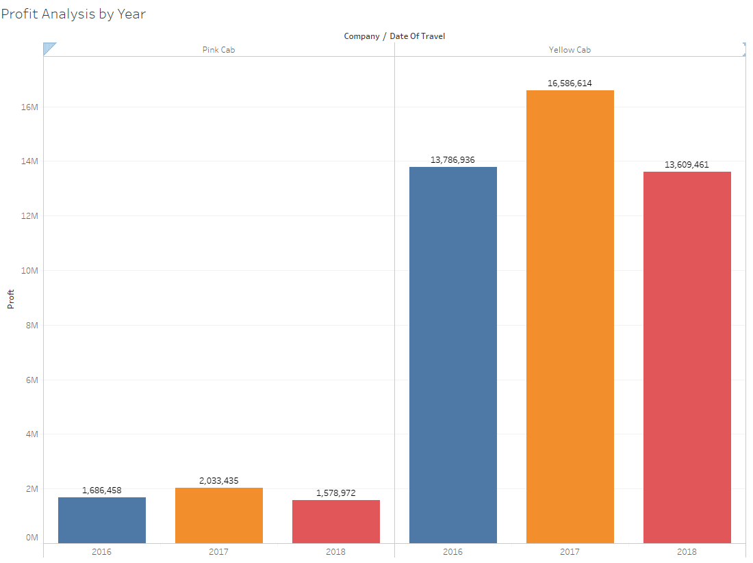
Profit Analysis by Year
Profit Analysis by year:
2016-2018. The bars show highest profit for Yellow cab in all three years.

Slide 5
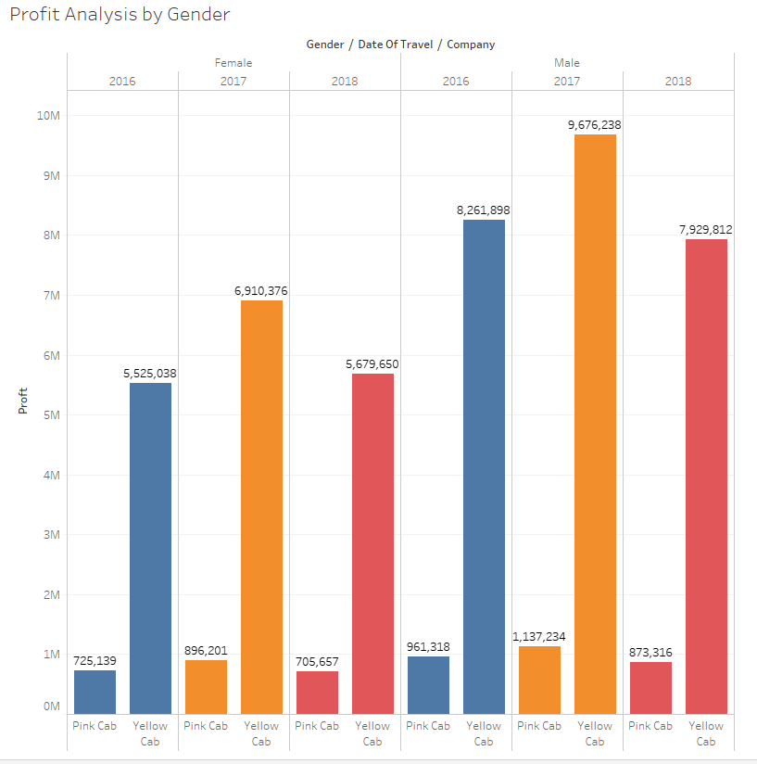
Profit Analysis by Gender
Profit Analysis by Gender: less profit is seen in pink cab riders regardless of gender and dates of travel in years (2016-2018)

Slide 6
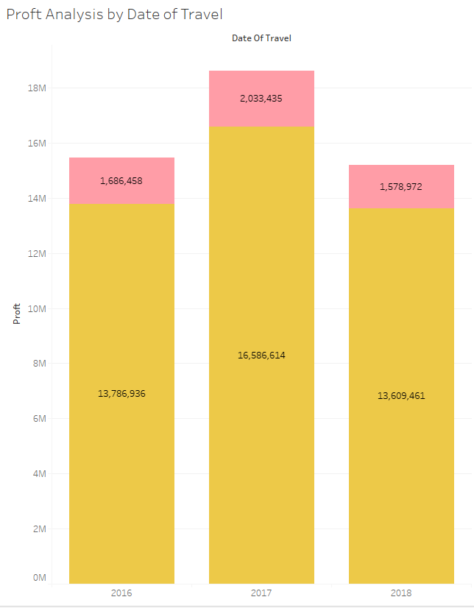
Profit Analysis by Date of Travel
Profit analysis by date of travel: The bars show consistent high profit for yellow cab and consistent low profits for pink cab from 2016-2018.

Slide 7
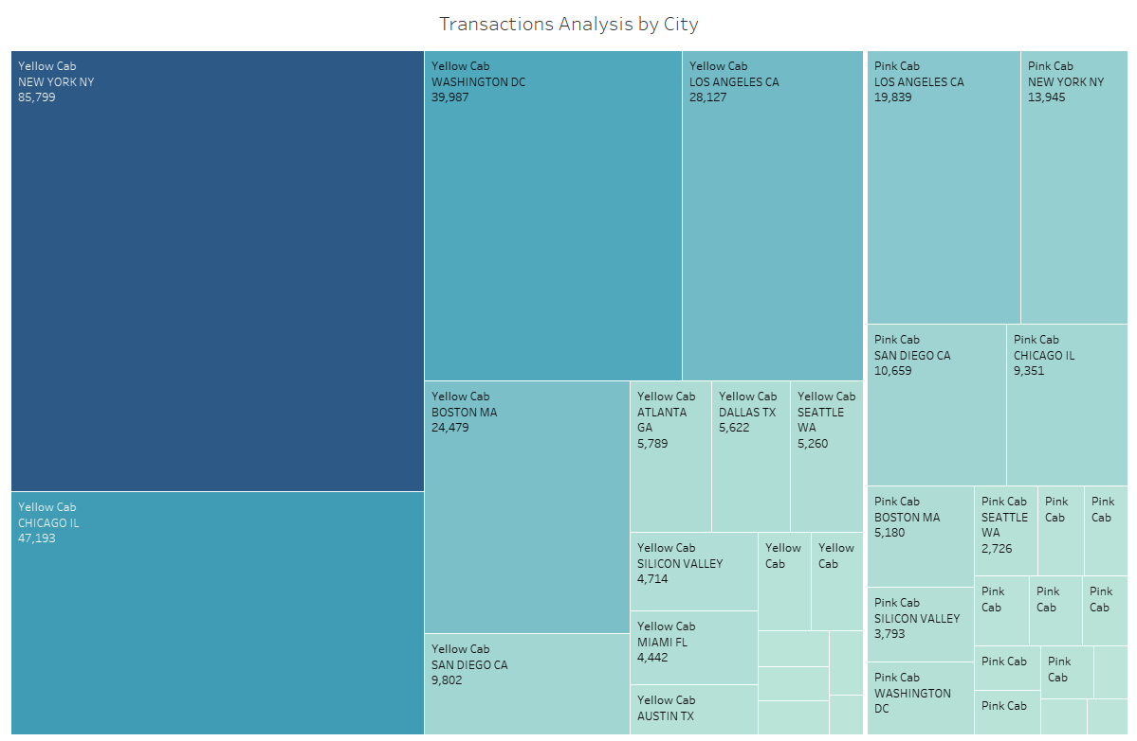
Transaction Analysis by City
Transaction analysis by city show highest number of transactions for yellow cab in New York.

Slide 8
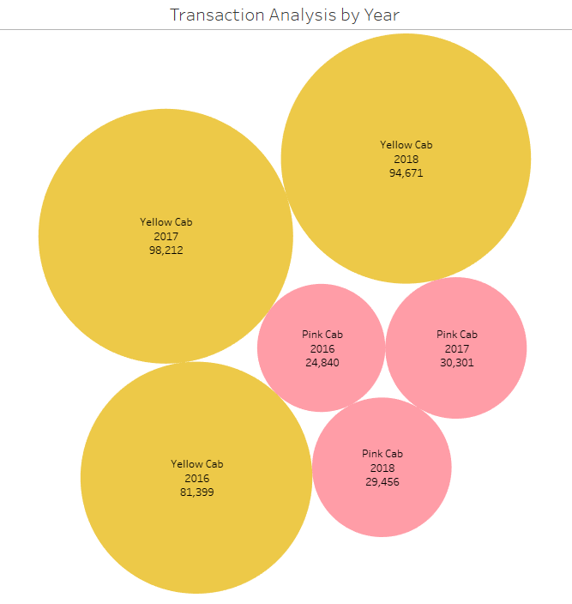
Transaction Analysis by Year
Transaction analysis by year show higher transactions for yellow cab in all three years (2016-2018) of data study.

Slide 9
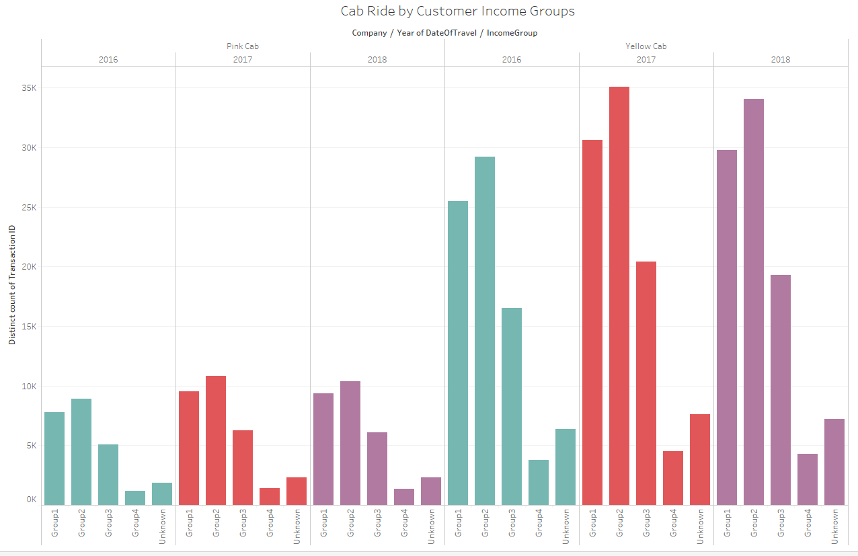
Cab Ride by Customer income Groups
Range of Income Groups
Group 1 1K - 10K
Group 2 11K - 20K
Group 3 21K - 30K
Group 4 31K - 40K
Group 5 Unknown
Yellow cab rides are more than pink cab rides in all income groups.

Slide 10
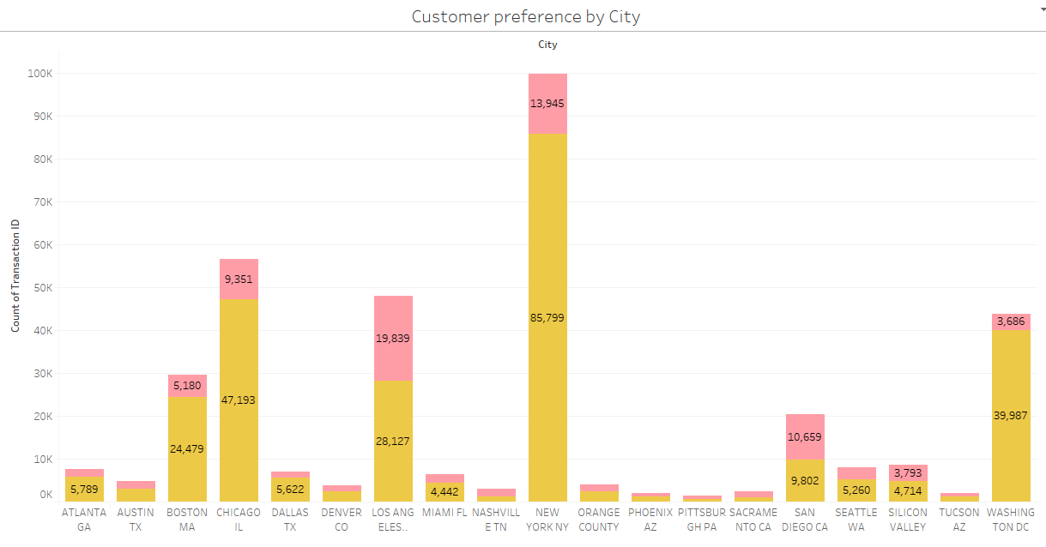
Customer Preference by City
Customer preference in majority of cities is higher for yellow cab. Few cities like San Diego, Sacramento, Nashville and Pittsburg have greater customer preference for pink cab.

Slide 11
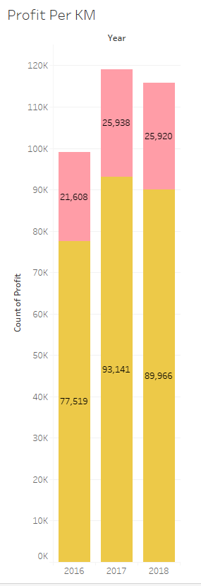
Profit Per Km Analysis
Profit per Km analysis show higher counts of profits for yellow cab in all three years (2016-2018).

Slide 12
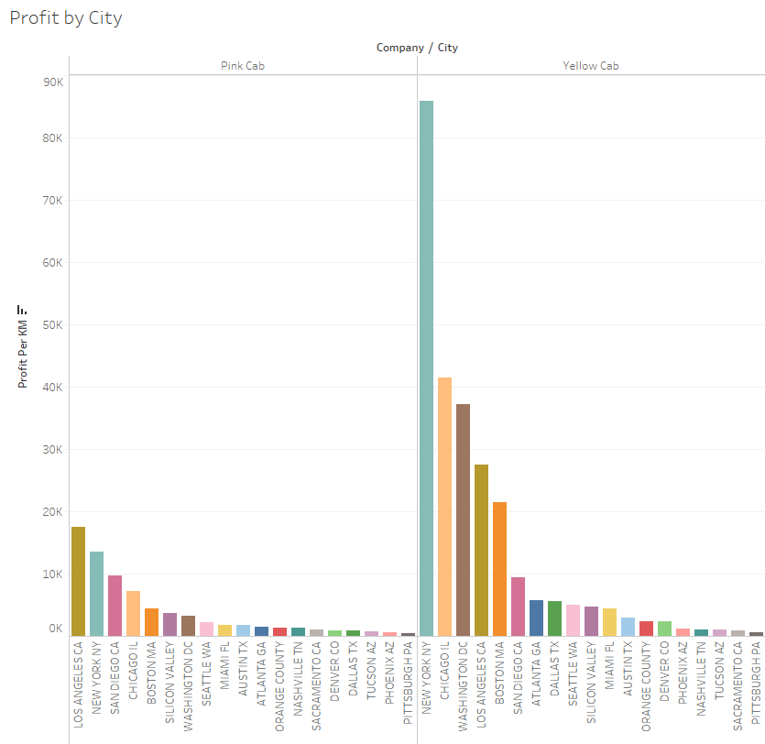
Profit by City Analysis
Profit by City Analysis

Slide 13
Recommendations:
After creating insightful visualizations, I have come to following recommendations for XYZ Business Firm:-
Data analysis done on customers’ income shows majority of cab riders prefer yellow cabs.
The group with unknown income (null values) rides yellow cabs more than pink cabs.
The highest profit in cab company is for yellow cab in big city like New York. Other cities also show more profit for riding yellow cabs as compared to pink cabs. Only Nashville, Sacramento, San Diego and Pittsburgh have slightly higher customer preference for Pink cab company.
When compared with New York, all other cities have less profit in cab company and cannot take the place of New York’s yellow cab company profits.
In all three years (2016, 2017, 2018) study of cab companies Pink cab is losing profit in a big difference with the rival Yellow cab company.
The analysis show gender difference in riding cabs as male to female ratio is more for riding yellow cabs as compared to pink cabs.
Based on all these recommendations, it is wise for XYZ Business Firm to invest in yellow cab company.

Slide 14

Thank You

